Slide 1
Case Study Presentation
Group 15 (Kanban-Gang)

Slide 2
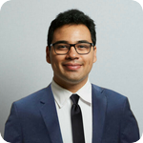
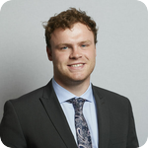

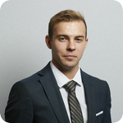

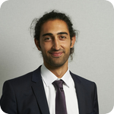
Team Members and Rotation Groups
Roles Assumed
Scum Master – James
Product Owner – Reuben
Development Team – Iuliia, Alex, Amy, Inan, Reuben, James
Rotation Groups
Database
Front-End React Application
OCP Deployment
Datagen and DAO
Web Server
James Brancale
Reuben Hughes
Iuliia Semchenkova
Li Chern (Amy) Yap
Inan Yigen
Alexander Davydov

Slide 3

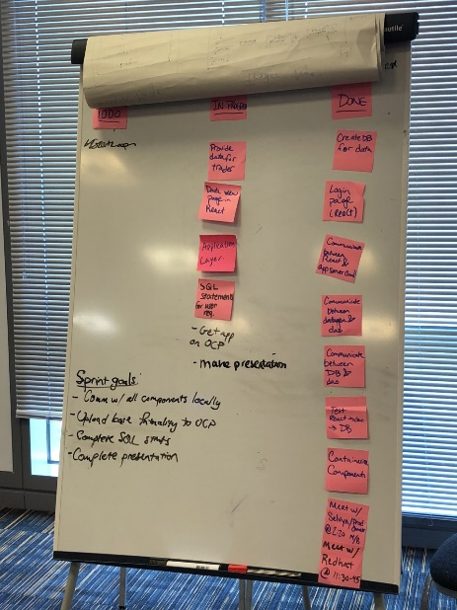
Our Agile Approach
Daily Communication
Daily Stand-Up (2x)
Daily Retrospective Session (2x)
Daily Reviews
Organisation & Coordination
Physical Kanban Board using sticky notes
Continuous Improvement
Test Driven Development (TDD)
Pair Programming
Group Rotations

Slide 4
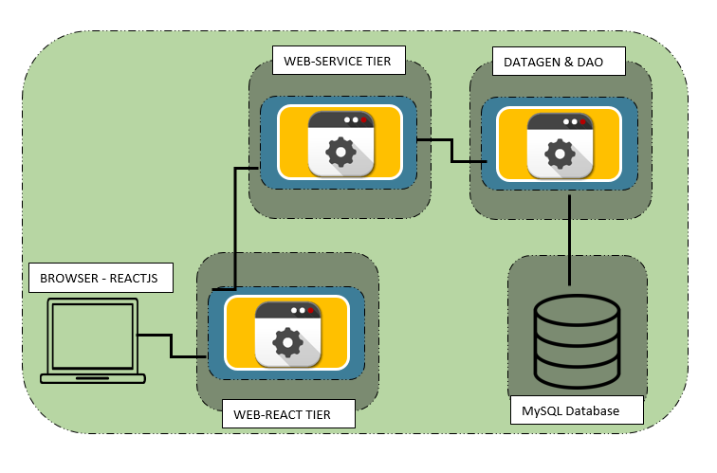
Our Technical Architecture
Rationale:
We chose the Four-Tier Architecture
The DAO tier is responsible for the data collection from and storage to the database
The Datagen and the DAO are in the same container
Web React handles user requests
Web Server does processing of the requests and business logic

Slide 5

Elements Accomplished
Architecture
React Application
Deploy MySQL
Database Queries
Meeting MVP requirements
Login Page
OCP Environment
Datagen and DAO
Processing User Events
User Requirements
Determined Type 1 Architecture
Encapsulate components with Flask
Connect Containers
Usability testing
Meeting with Product Owner
Accept Data
Display Reports
Communicating with Database
Develop SQL Queries
Processing User Events
Returning requested data
Deploy Datagen
Deploy React App
Accepting User Events

Slide 6
OCP Demo

Slide 7
Lessons Learnt
Hold more frequent meetings with the Product Owner for feedback
The fine balance between the intricate details and the project-wide goal
Take advantage of the community of project teams for guidance/help
Be open to new challenges and technologies

Slide 8
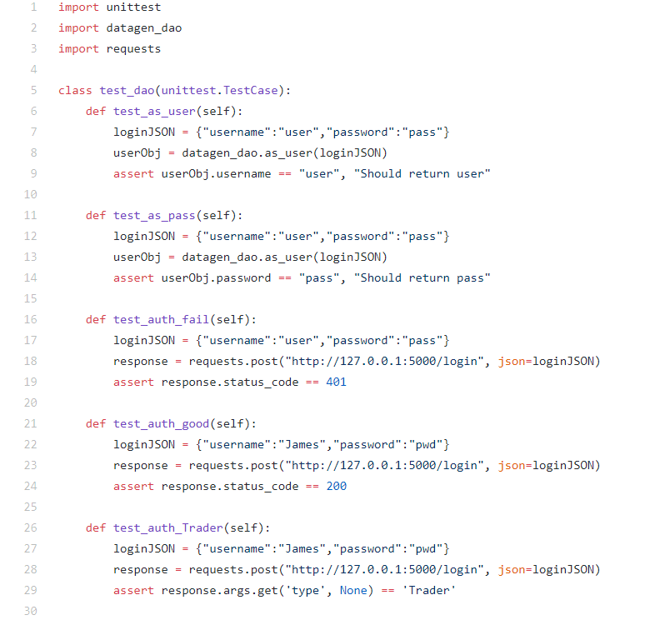

Slide 9
